Slide 1
Kenan Arbor/BP
-Anshul Kapoor
CAPS

Slide 2
Billing…..What is it all about?
The Billing System is an accounts receivable system that captures Service & Products usage & billing data, computes product & service charges, applies discounts & taxes etc, generates a bill or invoice and takes care of bill payment & settlement for the user.

Slide 3
Where does it fit into the OSS Framework?
Customer
Care
Customer Self Care
Order
Management
Subscriber Management
Services & Products Module
Pricing Module
BI / Data Warehousing
Credit Check
Trouble
Ticketing
QOS
Management
Market
Analysis
Sales
Network
Managers
PROVISIONING
Bill
Formatter
W
I
R
E
L
I
N
E
N
E
T
W
O
R
K
E
L
E
M
E
N
T
S
ACH
W
I
R
E
L
E
S
S
M
E
D
I
A
T
I
O
N
Taxware
C
A
B
L
E
RATING
BILLING
I P
S
E
R
V
I
C
E
Accounting
Invoicing
B
R
O
A
D
B
A
N
D
Risk
Management
U
T
I
L
I
T
I
E
S
SLA
Management
Fraud
Management
Electronic
Merchant
The ovals denoted in Green color could also be a part of Billing System in case of a complete Customer Care & Billing System

Slide 4
Billing System Functionality
Various modules addressing the basic functionality of a Billing Product :
System Administration
Account Management
Services & Product Module
Prices & Discounts Module
Rating
Billing
Invoicing
Payment Handling, Account Receivables & Settlement
Reporting

Slide 5

An overview of a typical
Billing Process
End User
2. Authorization & Authentication
Network Element Management & Network Elements
.
3.Usage Data
Aggregate
Network Data
Management
Collate
Collect
SLA Violations
4. Aggregated Usage Data
Discount
Rating & Discounting
Problem
Handling
Rate
Special Discounts
5. Summarized Bill Content
Invoicing & Collections
Collect
Subscriber &
Order
Management
Invoice
1. Activate Customer Account
Billing Cycle
7. Billing inquiry & Payments
6. Generate Bills
End User

Slide 6
Types of Billing:
Wireline Billing
IP Based Billing (Usage based)
Content Based Billing
Real Time Billing

Slide 7
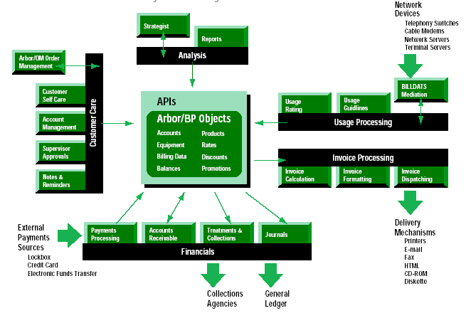
Arbor/BP System Overview

Slide 8
Overview of Arbor/BP ...
Arbor/BP Features
Flexible, Configurable Billing engine
Multi server architecture support
Oracle or Sybase compliant
Account Life cycle maintenance
Configurable and dynamic tables

Slide 9
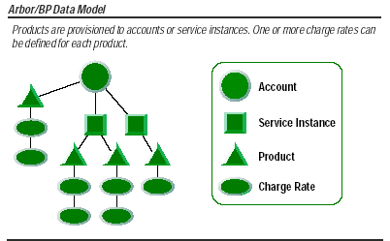

Slide 10
Arbor/BP Data Entities ...
Account
  Billable Entity
  Not a customer
  Stored in the Customer Master File table
  Can be linked together through a hierarchy
Subscription
  Is the network delivery point
  Has a unique External ID = Subscription ID
  Allows convergent billing
  Stored in the Equipment Master File table
  Synonymous with Service, Equipment, Service Instance
  Internal IDs are always unique

Slide 11
Arbor/BP Data Entities ...
Charge Domains (RC, NRC, Usage)
  Account (= Contract) or Subscription Level
Usage
  Customer driven network event collected outside of Arbor/BP
  Flexible usage rating (based on time of the day, target or duration)
  Usage types are grouped and the Usage Type Group is associated with RCs
  example, the Telephony Usage type group can contain the usage type for Long distance call, Local call, Call waiting, etc.
  One RC can have only one UTG

Slide 12
Arbor/BP Data Entities ...
Discount
  Reduces charge amounts (% off or $ off)
  Bulk or Incremental
  Can be applied to any charge domain
  Account or Subscription level
  Must belong to a Discount Plan
Unit Credit
  Free usage or monetary rebate
  Account or Subscription level
  Can be independent of a bill cycle (only through a contract)
  Must belong to a Unit Credit Plan

Slide 13
Arbor/BP Data Entities
Contract
  Used for duration based promotions
  Bundles entities for ease of provisioning
  Allows automatic charge for activation or early termination
  Contract can have 2 NRCs (Activation and Termination), 1 RC, 1 DP, 1 UCP
Package
  Promotional and Provisioning tool (Bundling Vs a la carte)
  Contains components
  Components can contain only Contracts and RCs as members
  1 Required Component and 0 or more Optional components
  Components can be reused in other packages
  Component can be at Account or Subscription level
  Package is always at Account level

Slide 14
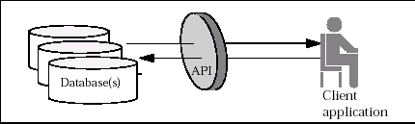
API Functions and the Arbor/BP Database

Slide 15
What the API’s let do ?
Create, select, edit, and terminate accounts and service instances.
Provision products, contracts, discounts, payments, charges, adjustments, and other entities to an existing account or service instance.
Obtain information about provisioned entities and other account or service instance properties.
Obtain information about Arbor/BP servers.
Calculate charge amounts (rate quotes) for usage events, products, and other charge-generating entities.

Slide 16
Objects in Arbor/BP
Arbor/BP has a set of objects which represent the data model.
The “objects” of Arbor are build on procedural C language not C++ so the objects do not have all the OO properties i.e. inheritance etc.
Four kinds: Based on Types of Operations
  Dynamic Objects e.g. Account
  Update-Only Objects e.g. EFT
  Read-Only Objects e.g. Invoice
  Transient Objects

Slide 17
Functions
Constructors, destructors, and iterators
  new_abp_ object ()
  delete_abp_ object(void *obj);
  data_type next_abp_ object( data_type obj);
Field accessors
  Get, Set, Unset, Null
Database operators
  Insert, Select, Update, Cease.

Slide 18
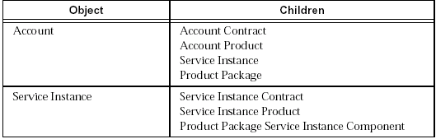
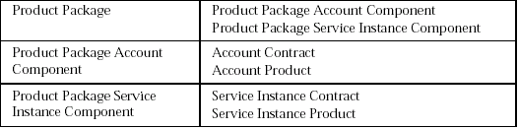
The Family…Parents & Children

Slide 19
Web Enabling of Arbor for Telenet
Front End
OMS
Interface Beans
NATIVE LIB LOADER AND SYNCHRONISER LAYER (Java)
JNI Wrapper Layer
High Level C APIs
Arbor/BP Low Level APIs
Database

Slide 20
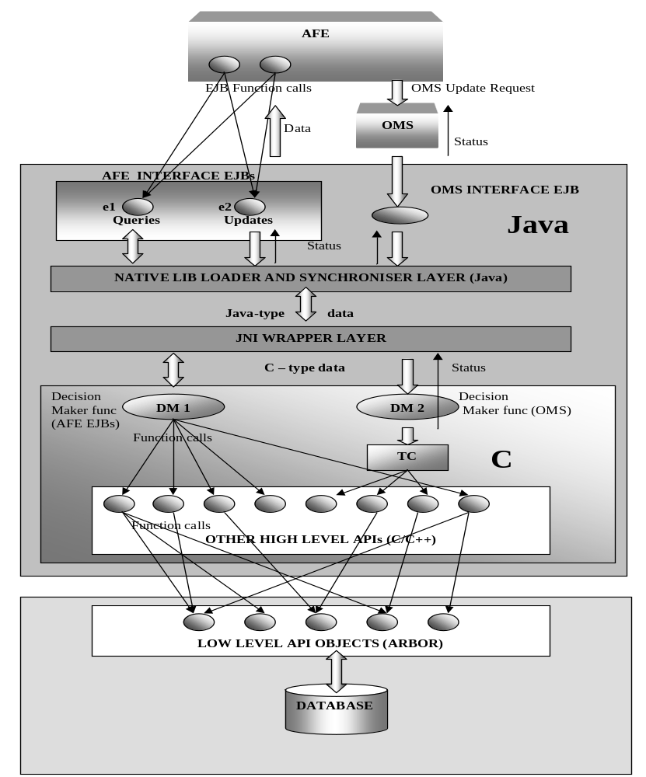
Design for Telenet Arbor Layer.

Slide 21
Thank You

